Slide 1

7.5-minute video on what is the grid 9/19/2022 Scientific American
https://youtu.be/X2eYdAR0ka4

Slide 2
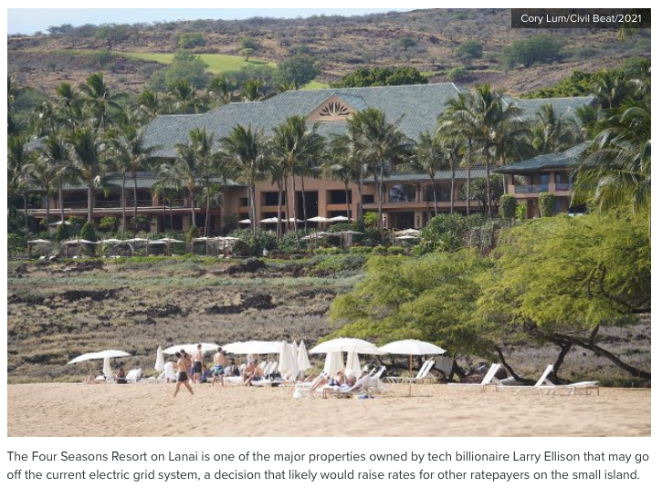
10/2/22
https://www.civilbeat.org/2022/10/larry-ellison-wants-off-lanais-electric-grid-that-could-be-a-problem-for-everyone-else/

Slide 3
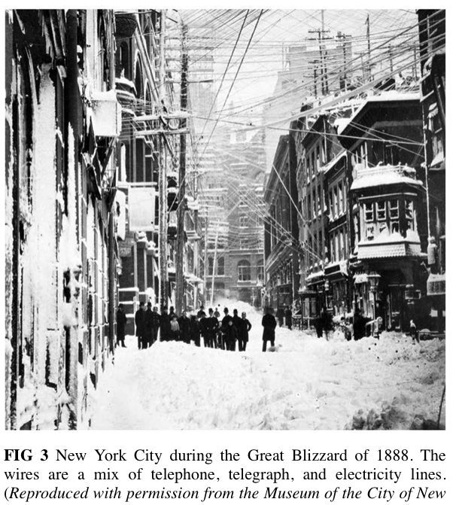
DC grid with different lines for different voltages
Maximum 1 mile
AC buried lines transmitted from northern Canada

Slide 4


Slide 5
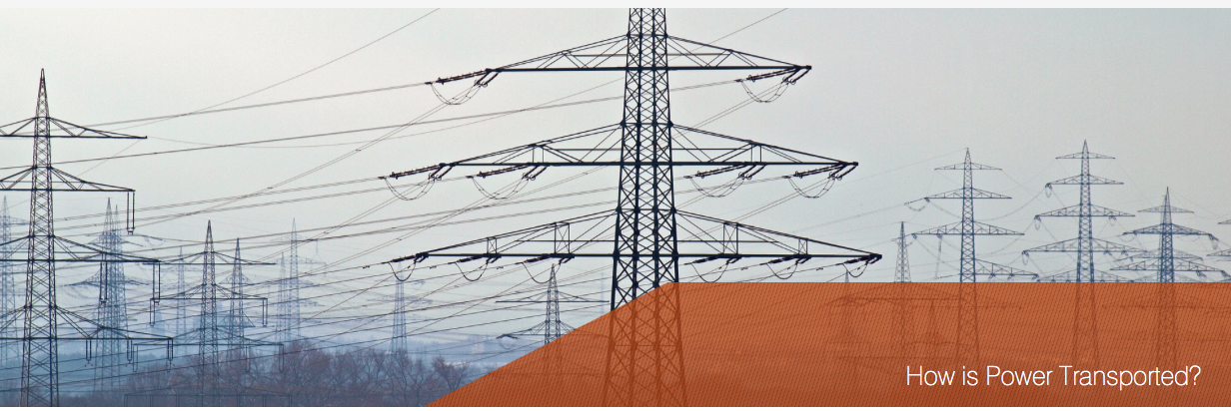

Slide 6
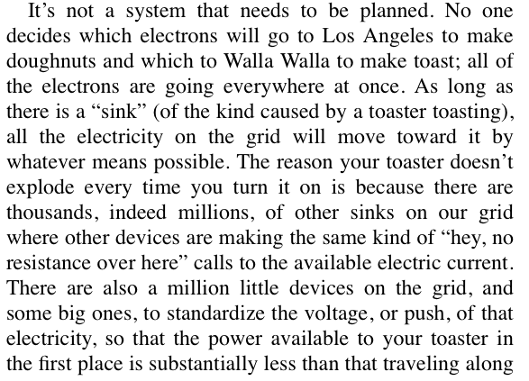
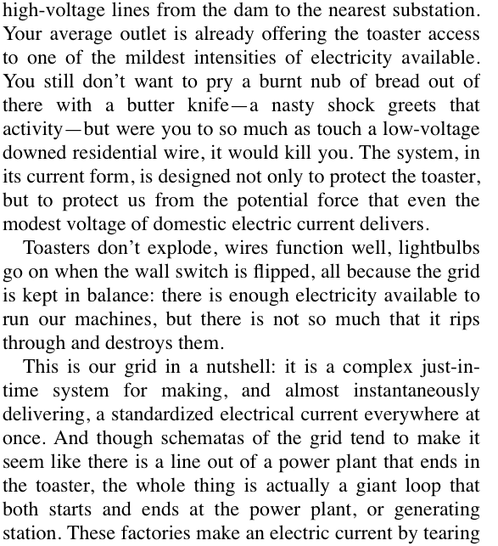
The Grid
-Currently almost no storage (JIT system)
-Delivery in much less than 0.1 s from production
-Not much control; source and sinks and resistance govern
(distance doesn’t matter much)
-Loss in transmission is only about 7%
- 1/5 of US power plants were build in the 1950’s
-All will need to be replaced in 30 years (2050)

Slide 7
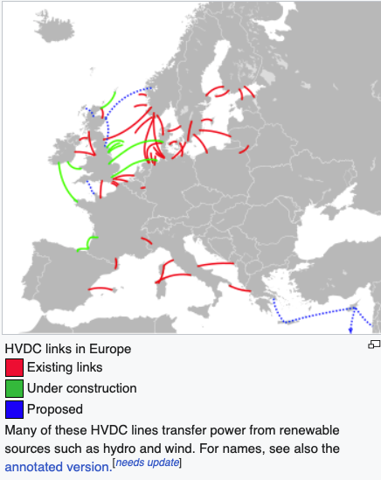
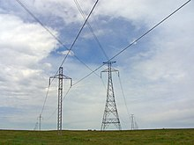
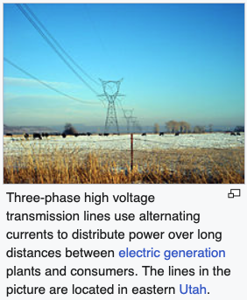
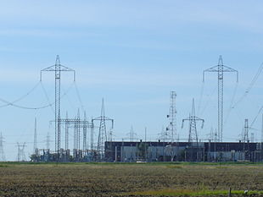
High Voltage DC North Dakota (Wind harvest)
3-Phase AC in Utah
Hydro Quebec High Voltage DC 1,000 kW

Slide 8
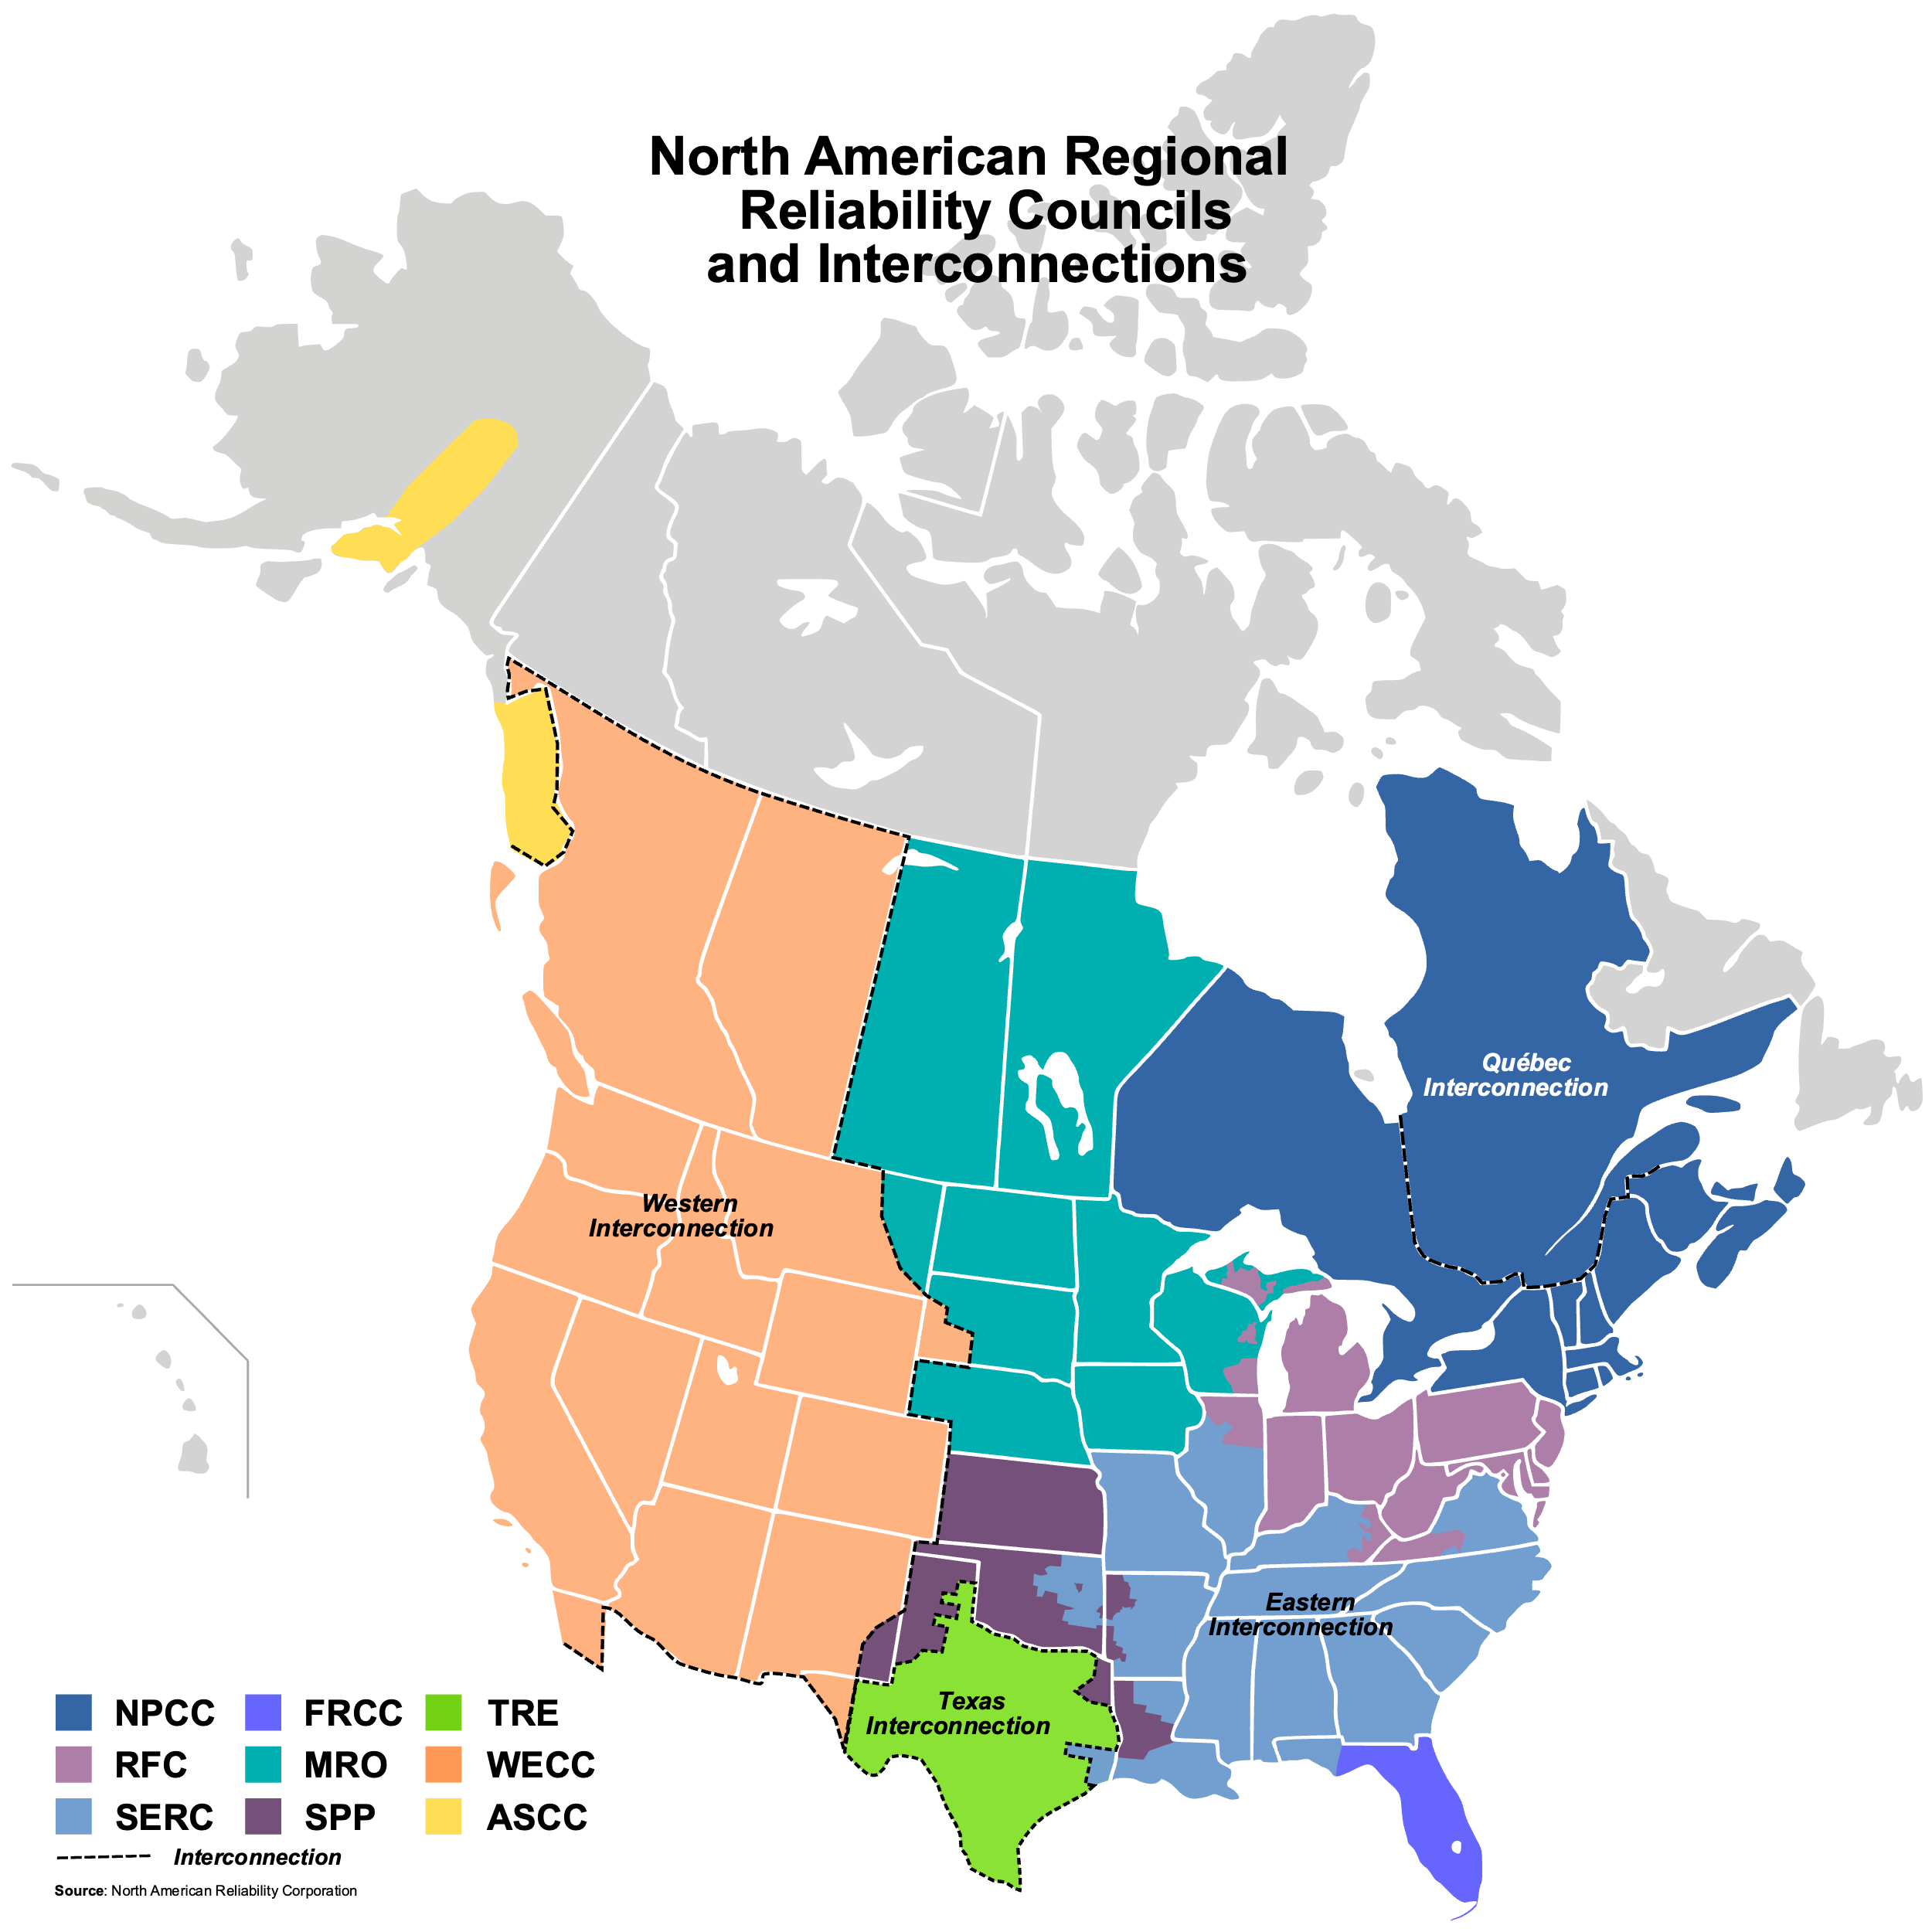

Slide 9
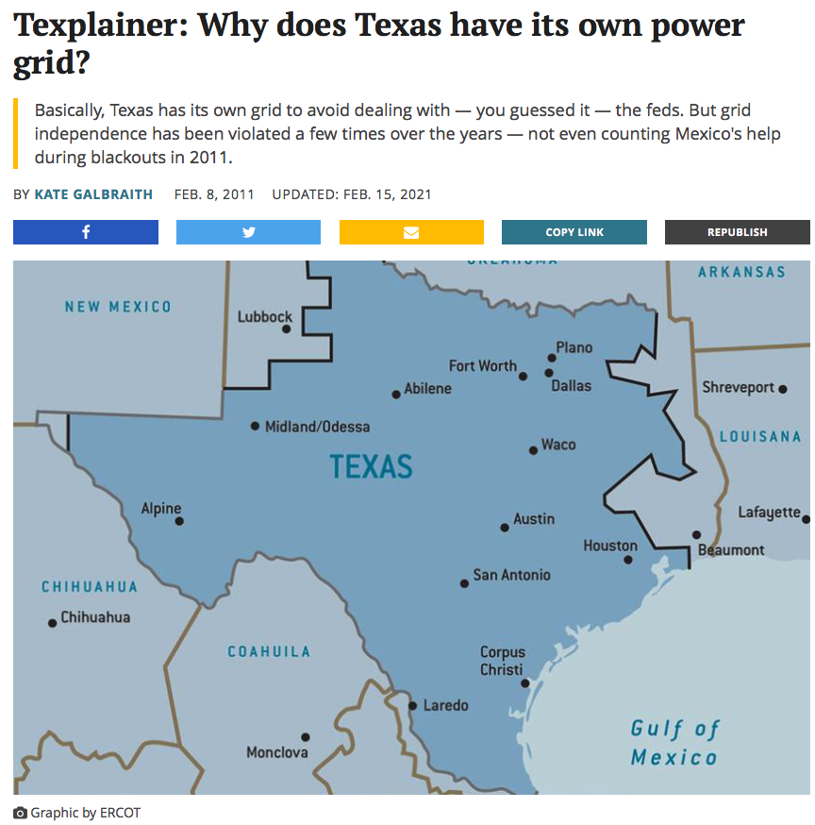

Slide 10
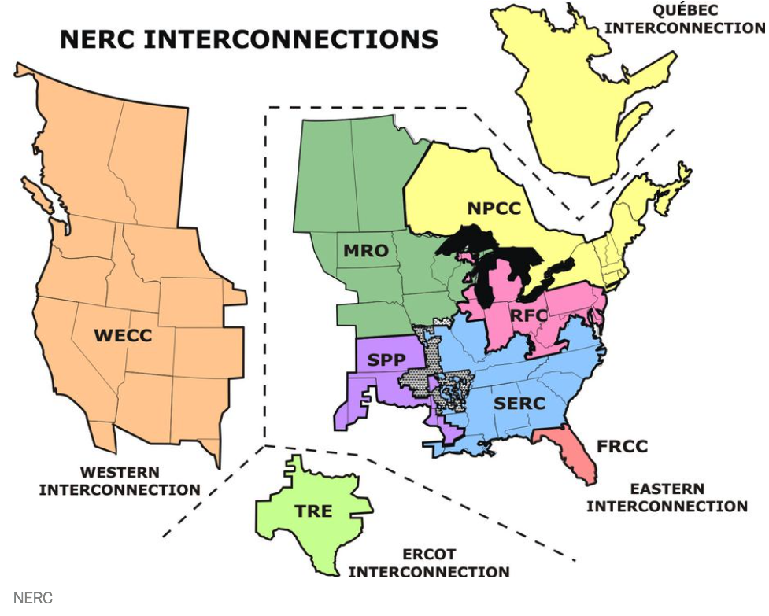

Slide 11
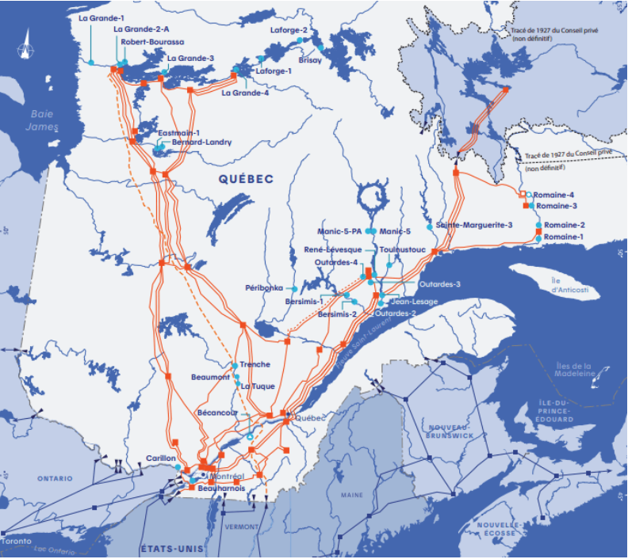

Slide 12
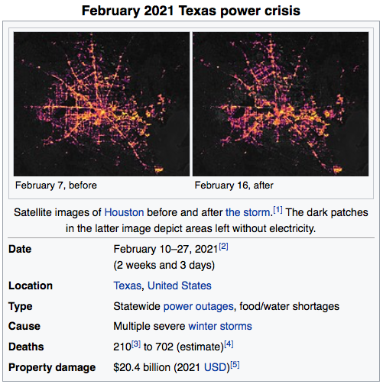
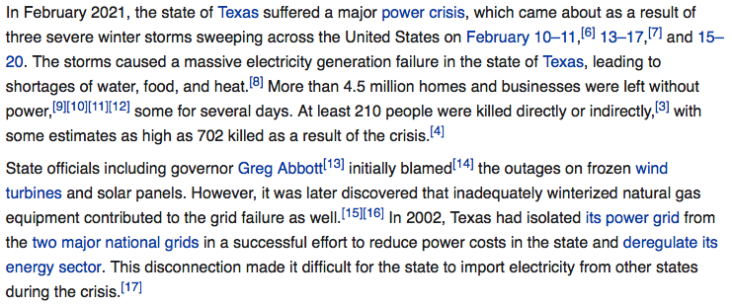
https://www.nbcdfw.com/investigations/nbc-5-investigates-how-communication-failures-left-texas-unprepared-and-powerless-in-february/2588164/?_osource=db_npd_nbc_kxas_eml_shr

Slide 13
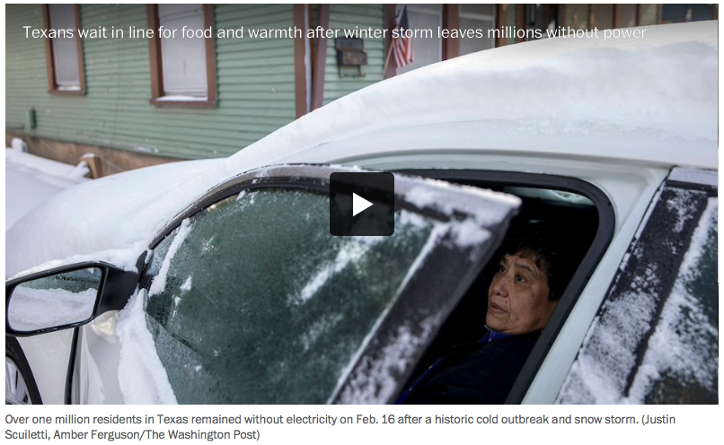

Slide 14
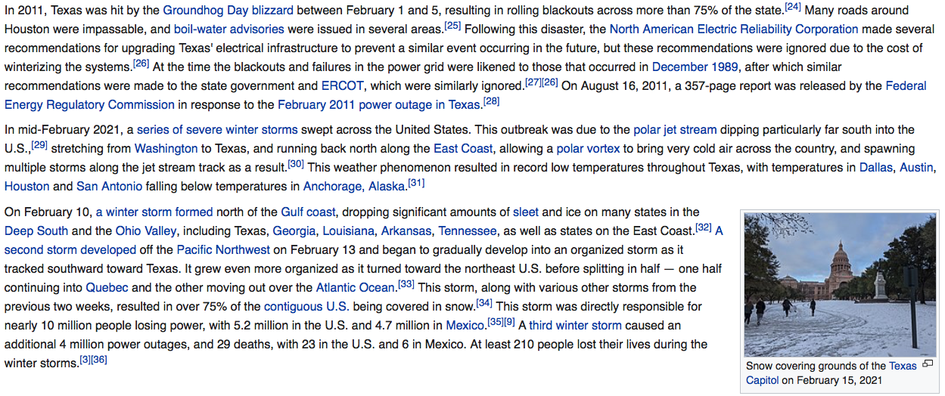

Slide 16
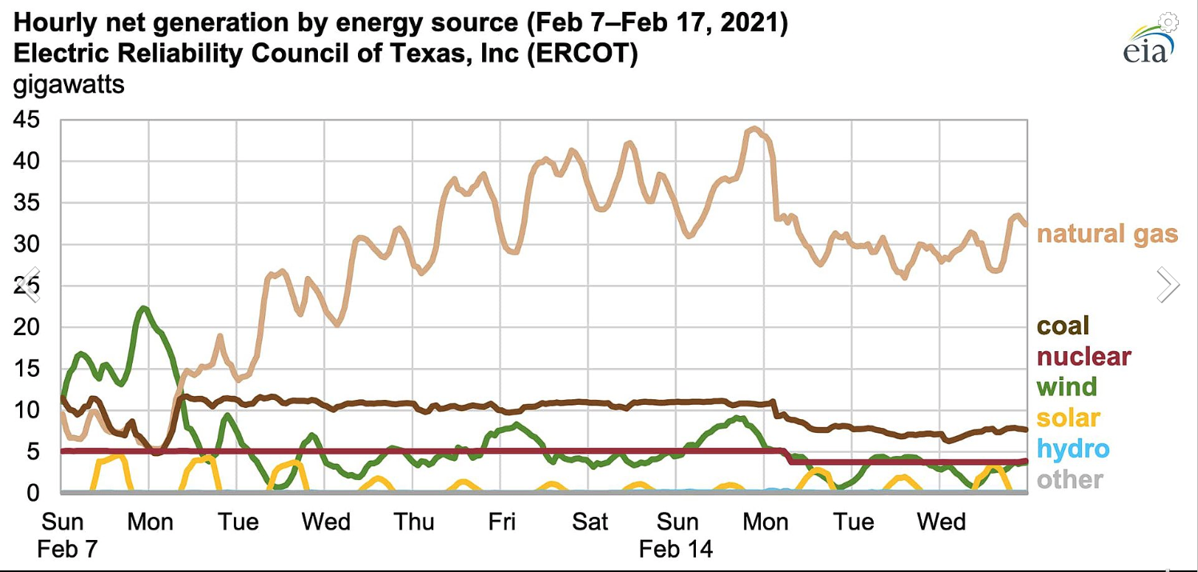

Slide 17
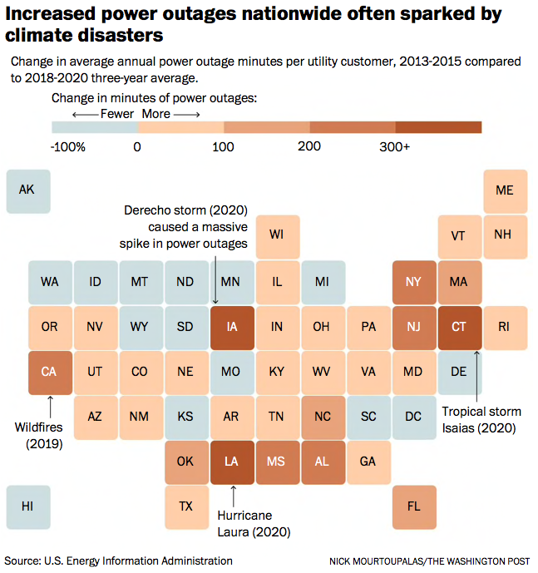
Problems with the grid and climate chaos exacerbate each other
From Washington Post Article 10/24/2021

Slide 18
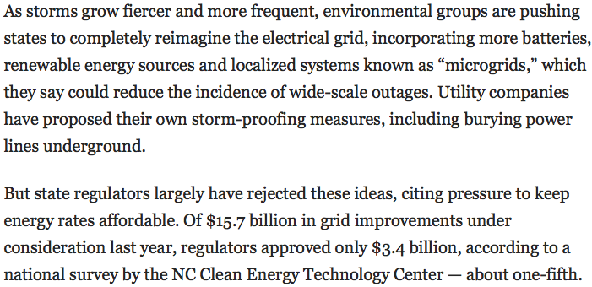
Problems with the grid and climate chaos exacerbate each other
From Washington Post Article 10/24/2021
More batteries
Renewable sources
Microgrids
Bury power lines
Nobody wants to pay for it

Slide 19
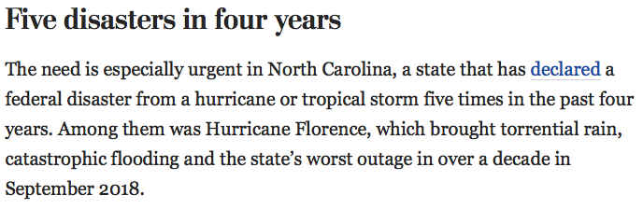
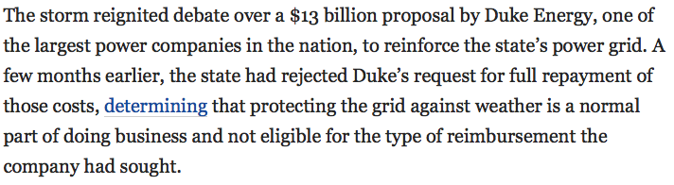
Problems with the grid and climate chaos exacerbate each other
From Washington Post Article 10/24/2021
Nobody wants to pay for it

Slide 20
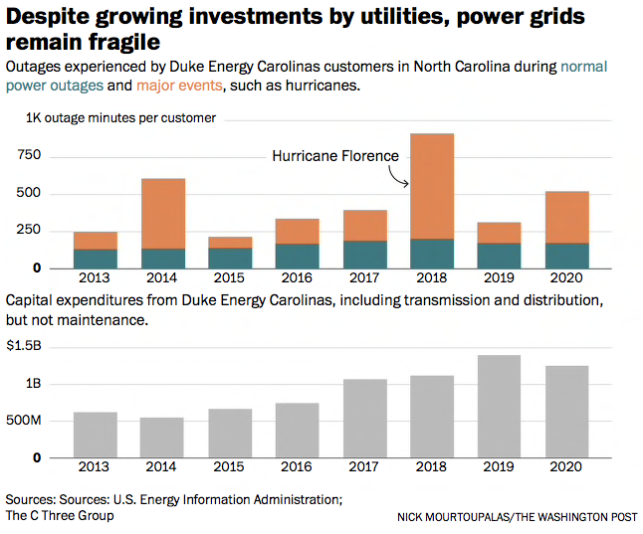
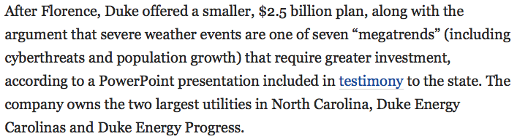
Problems with the grid and climate chaos exacerbate each other
From Washington Post Article 10/24/2021

Slide 21
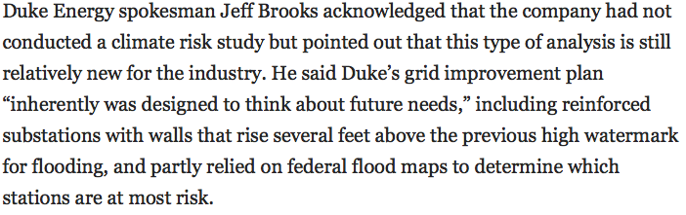
Problems with the grid and climate chaos exacerbate each other
From Washington Post Article 10/24/2021

Slide 22
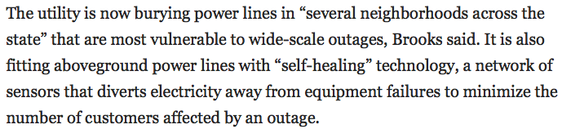
Problems with the grid and climate chaos exacerbate each other
From Washington Post Article 10/24/2021

Slide 23
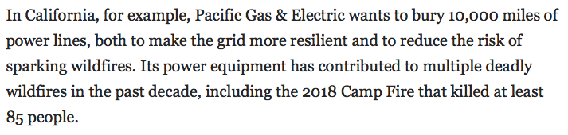
Problems with the grid and climate chaos exacerbate each other
From Washington Post Article 10/24/2021

Slide 24
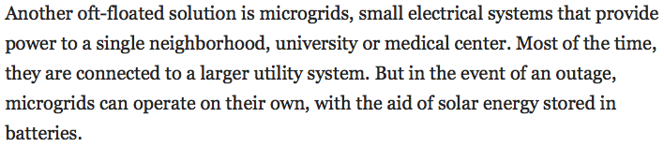
Problems with the grid and climate chaos exacerbate each other
From Washington Post Article 10/24/2021
Florida Approved Microgrid Test Project
Maryland Rejected for Baltimore

Slide 25
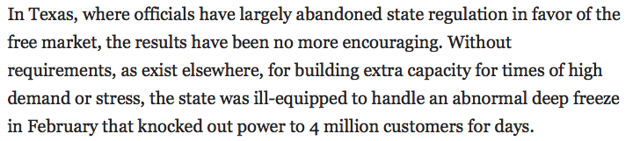
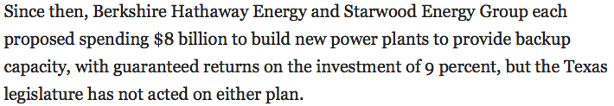
Problems with the grid and climate chaos exacerbate each other
From Washington Post Article 10/24/2021

Slide 26
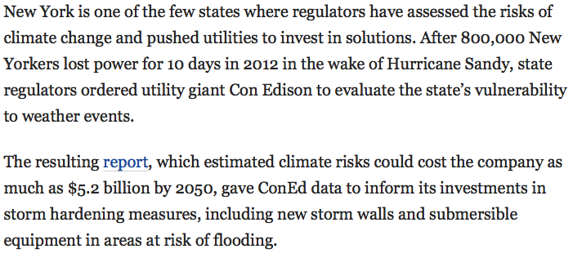
Problems with the grid and climate chaos exacerbate each other
From Washington Post Article 10/24/2021

Slide 27
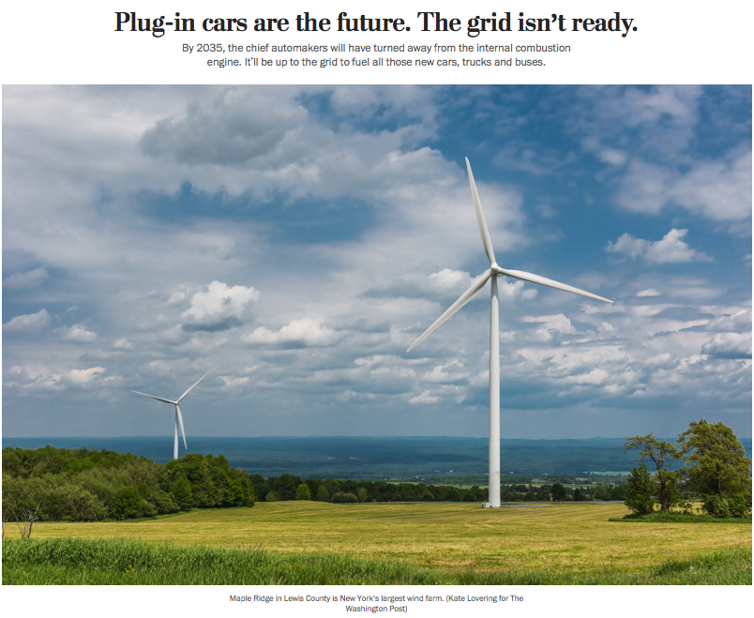
Washington Post October 13, 2021

Slide 28
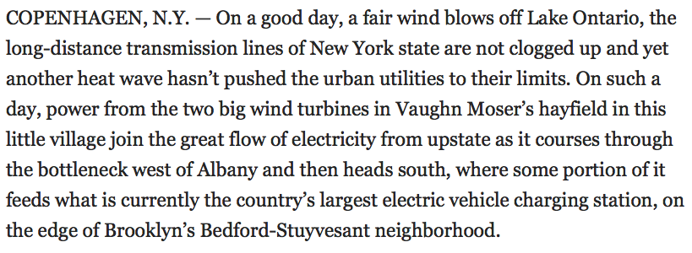
Washington Post October 13, 2021

Slide 29
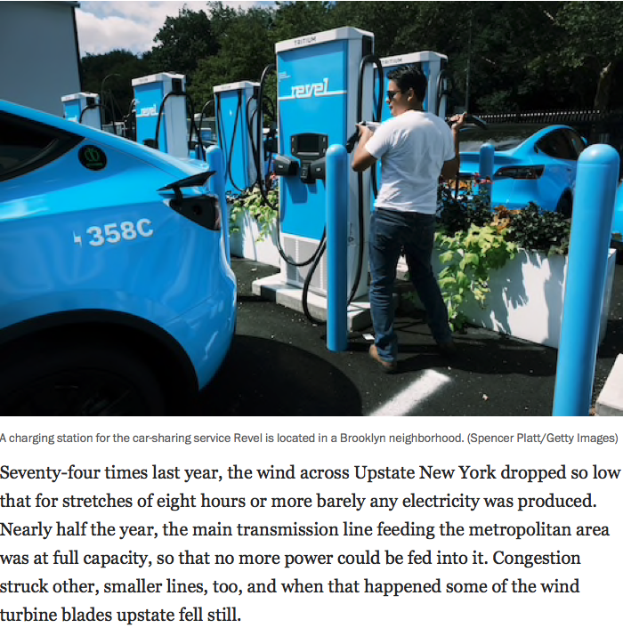
Washington Post October 13, 2021

Slide 30
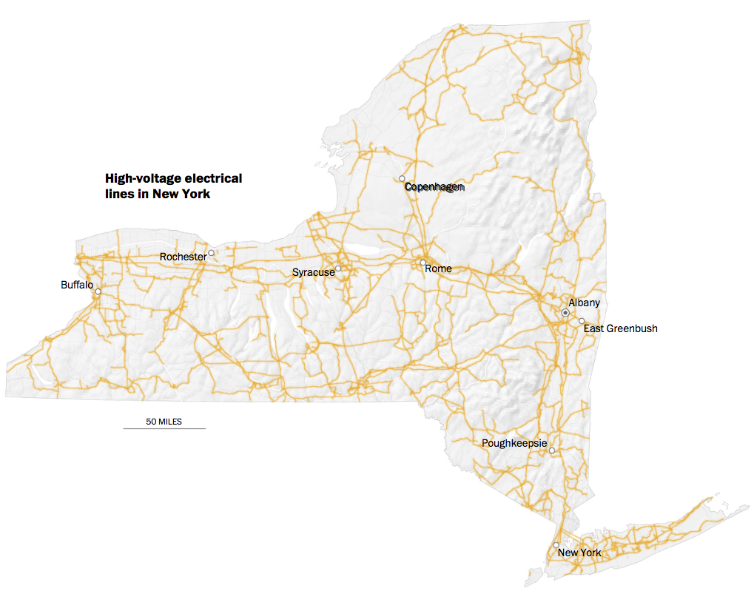
Washington Post October 13, 2021

Slide 31
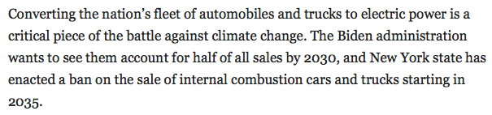
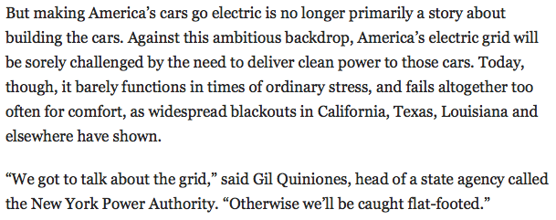
Washington Post October 13, 2021

Slide 32
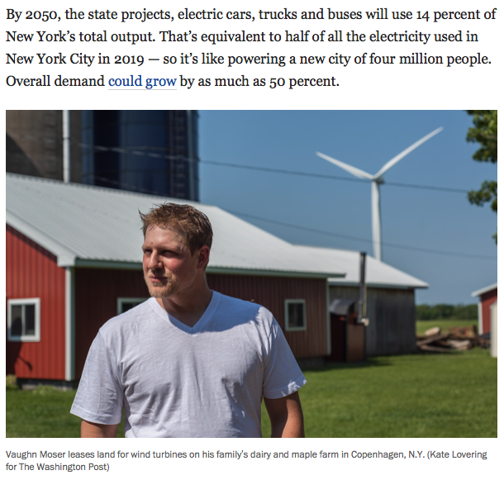
Washington Post October 13, 2021

Slide 33
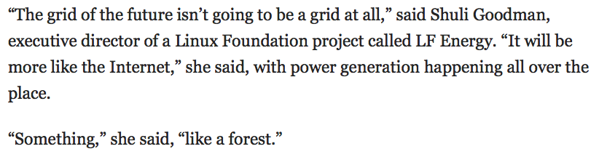
Washington Post October 13, 2021

Slide 34
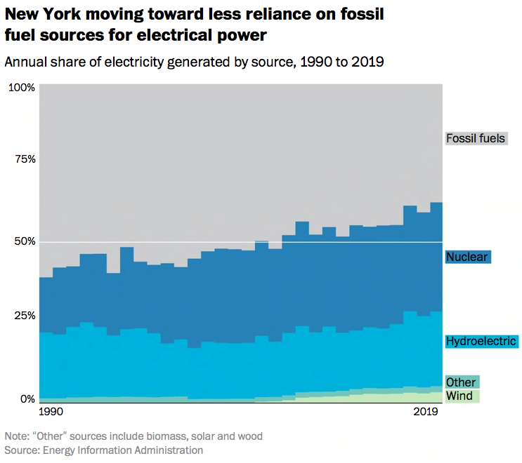
Washington Post October 13, 2021

Slide 35
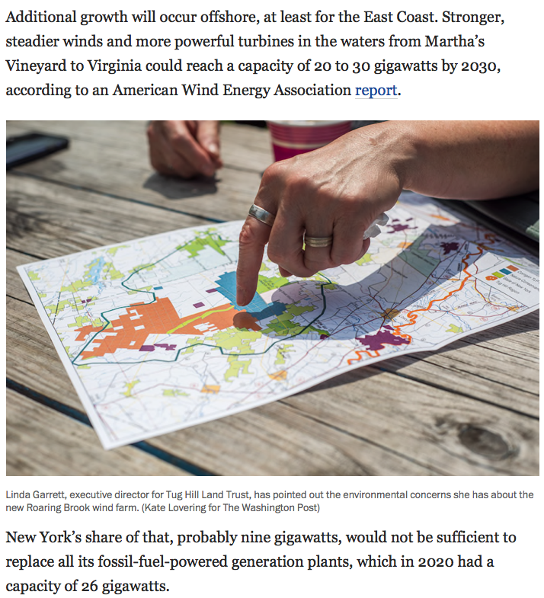
Washington Post October 13, 2021

Slide 36
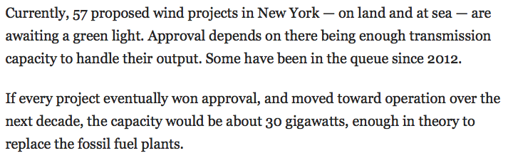
Washington Post October 13, 2021

Slide 37
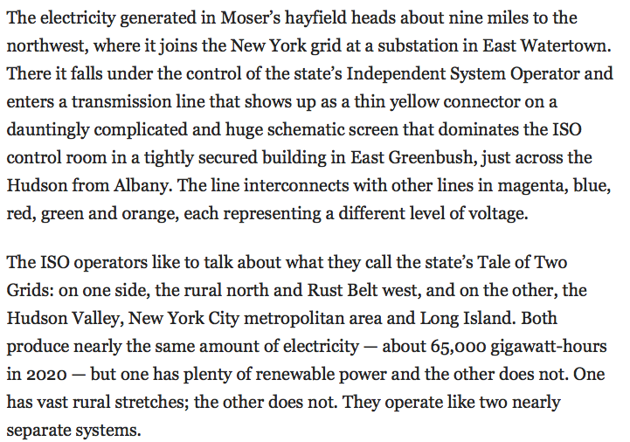
Washington Post October 13, 2021

Slide 38
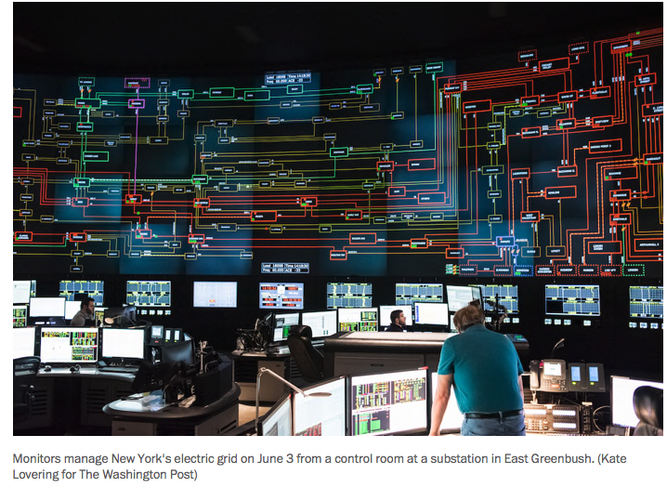
Washington Post October 13, 2021

Slide 39
Washington Post October 13, 2021

Slide 40
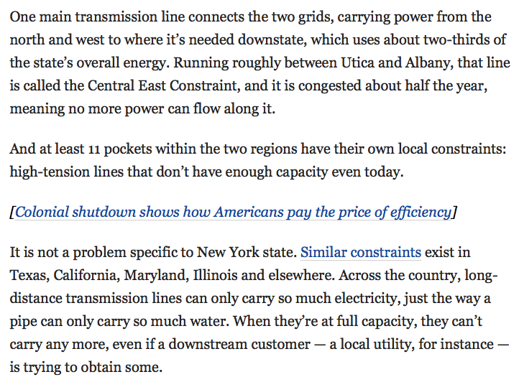
Washington Post October 13, 2021

Slide 41
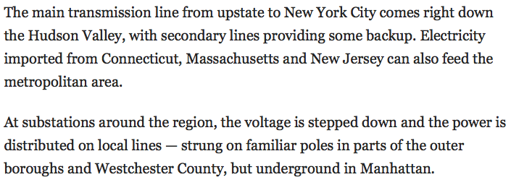
Washington Post October 13, 2021

Slide 42
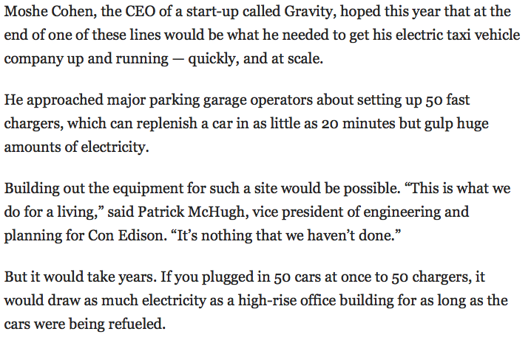
Washington Post October 13, 2021

Slide 43
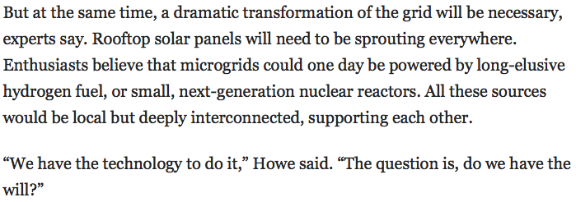
Washington Post October 13, 2021

Slide 44
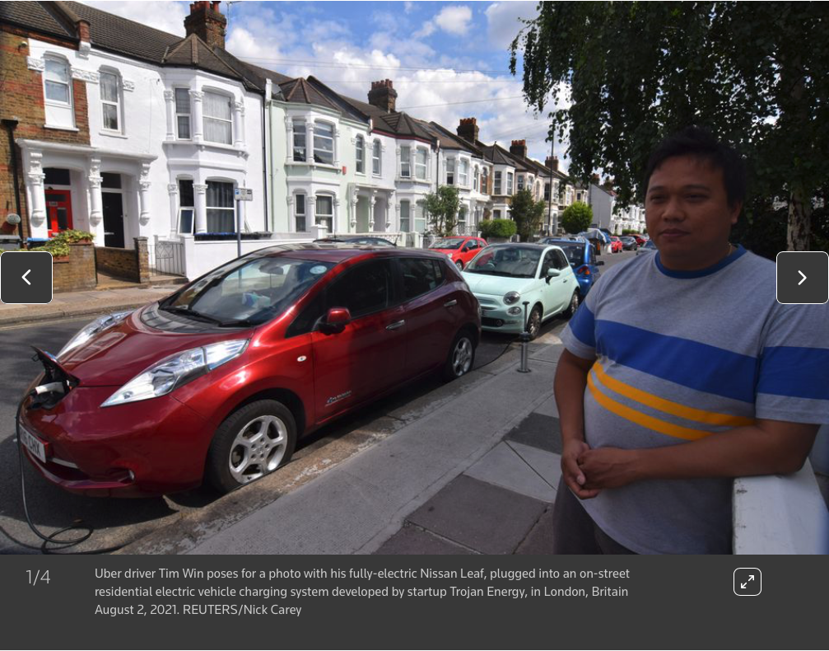
Reuters October 13, 2021

Slide 45
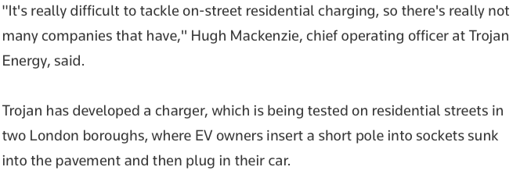
Reuters October 13, 2021

Slide 46

Reuters October 13, 2021

Slide 47

Reuters October 13, 2021

Slide 48

Reuters October 13, 2021

Slide 49

Reuters October 13, 2021

Slide 50

Reuters October 13, 2021

Slide 51

Reuters October 13, 2021

Slide 52

Reuters October 13, 2021

Slide 53


Slide 54

Visualizing the Grid

Slide 55


Slide 56
44,0000 Ethiopia Renaissance Dam

Slide 57

Blackout August 2003
Davis-Besse Nuclear Plant wiki

Slide 58


Slide 59

(PMU Phase measurement unit)

Slide 60

Power sources and need are separated by large distances
Western Doughnut

Slide 61


Slide 62


Spinning generators
On demand power
Uncertainties with renewable generation
Transmission and distribution
Supervisory control and data acquisition

Slide 63


Slide 64


Slide 65


Slide 66

By 2050 (30 years) every power plant in the US will need to be replaced by new plants.
2008 to 2015 wind increased by 300%
solar increased by 2,000%
The grid is rapidly changing

Slide 67
Renewable energy generation
Variable generation:
US 7% (but this is localized)
Texas Wind is 9%
Oregon Wind is 13%
Iowa Wind is 30% of the grid
September 2015 Price per megawatt in north Texas was $-0.64 (negative!!)
The grid had too much power input due to wind (and inability to export power due to isolation)
US Military has microgrids for all US bases
Same for most Universities
Google, Microsoft, Citibank etc.
The ”utility” is becoming just an operator of the grid and a handful of plants.
With renewables storage becomes a main issue.

Slide 68

Utility death spiral

Slide 69

DOE 2015 Quadrennial Technology Review

Slide 70


Slide 71


Slide 72
Your car is an under used resource
Drive to work, 1 hour, drive home 1 hour
22 hours not used
Could draw from the grid at night
(in the suburb where there is excess energy)
Add to the grid during day
(in the city where it is most needed)
Use the car as a portable energy source/sink
22 hours per day
If you get free fuel and some money
this becomes interesting

Slide 73

Renewable Production Peaks at Midday
Curves are scaled
To match at 3 am or so

Slide 74


Slide 75
Load Balancing

Slide 76




Slide 77
Grid Energy Storage
Currently used on grids
Water Storage (Ludington, MI)
Gas Storage (Compressed Air CAES)
Battery Storage (Iowa)
Fly Wheel (Beacon Flywheel)
Used in small scale
Electric water heaters
Electric Cars
Ice based air conditioners
Thermal Energy, Molten Salts
Hydrogen
Superconducting Magnet
Capacitors
Syn-Gas
Proposed
Liquid Air
Gravitational

Slide 78

Grid Energy Storage
The CAES power plant can generate more than 132 million kWh of electricity annually, providing electricity for 40,000-60,000 households during peak electricity consumption. It will save around 42,000 tons of standard coal and reduce carbon dioxide emissions by 109,000 tons annually.
10/5/22 https://www.inceptivemind.com/china-worlds-largest-compressed-air-energy-storage-plant-connected-grid/27685/

Slide 79

Grid Energy Storage
10/4/22
https://www.inceptivemind.com/china-connects-worlds-largest-flow-battery-energy-storage-station-grid/27631/

Slide 80
Grid Energy Storage
Currently used on grids
Water Storage
Gas Storage
Battery Storage
Fly Wheel
Used in small scale
Electric water heaters
Electric Cars
Ice based air conditioners
Thermal Energy, Molten Salts
Hydrogen
Superconducting Magnet
Capacitors
Syn-Gas
Proposed
Liquid Air
Gravitational

Slide 81
Grid Energy Storage
Currently used on grids
Water Storage
Gas Storage
Battery Storage
Fly Wheel
Used in small scale
Electric water heaters
Electric Cars
Ice based air conditioners
Thermal Energy, Molten Salts
Hydrogen
Superconducting Magnet
Capacitors
Syn-Gas
Proposed
Liquid Air
Gravitational
In the US 2018

Slide 82


Slide 83


Slide 84
Grid Energy Storage
Number of Deployed Storage Technologies

Slide 85


Ice Bear

Slide 86

https://www.theatlantic.com/science/archive/2022/09/electric-cars-help-california-electricity-grid/671420/

Slide 87

SmartGridCity
Boulder CO
2008-2010
XCEL

Slide 88


Slide 89


Slide 90


Slide 91


Software to simulate micro grids (Homer)

Slide 92


Slide 93

Modeling and control of the grid

Slide 94

Modeling and control of the grid

Slide 95



Slide 96
The grid will play a larger role in our lives
Getting off the grid and having grid independence seems to be a growing issue after Sandy and other storms
There are jobs in this sector, but it is difficult to define where they are, nobody is an expert right now (that is a good thing for a job seeker)
In the developing world there may be potential to build it right or to skip the gird altogether and leapfrog to a new microgrid future based on alternative energy
It is important to consider who is benefiting from technical advances, monitoring and control

Slide 99



Slide 100

Tanzania Grid Electricity Source

Slide 101

Comparison of Grid/PV/Diesel in Africa

Slide 102
In the developing world the issue is partly no grid
The answer may be microgrid or off grid
An economic assessment of the advantages of the grid is needed

Slide 104


Slide 105



Slide 106



Slide 107


Slide 108




Slide 109




Slide 110



Slide 111


Slide 112


Slide 113



Slide 114



Slide 115


Slide 116



Slide 117


Slide 118


Slide 119



Slide 120





Slide 121


Slide 122
Nano-grid
Micro-grid
Peak Load
Load Shifting

